Slide 1
Operating Systems
Dr. Lucy J. Gudino
Dept. of CS and IS

Slide 2
Objectives and scope of this course
To provide understanding of the functions of operating systems
To provide insight into functional modules of operating systems
To study the concepts underlying the design and implementation of operating systems
To study the basics of Linux O.S.

Slide 3
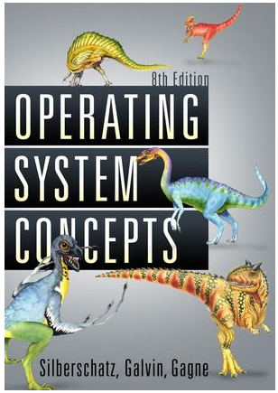
Text Book
Operating System Concepts
By
ABRAHAM SILBERSCHATZ
PETER BAER GALVIN
GREG GAGNE
Eighth Edition
(WILEY STUDENT EDITION)

Slide 4
Reference Books
OPERATING SYSTEMS, Internals and Design Principles, Fifth Edition by William Stallings
Modern Operating Systems by Andrew Tanenbaum
Unix Shell Programming by Yeshwant Kanetkar
Internet

Slide 5
Evaluation
Evaluation Component | Mode | Duration | Weightage | Date and Time
Test – I | Closed Book | 1 hour | 20% | 17.09.13 (10.30 to 11.30)
Test – II | Closed book | 1 hour | 20% | 27.10.13 (10.30 to 11.30)
Comprehensive | Closed Book | 3 hours | 30% | 09.12.13 (AN)
Quiz & tutorial | - | - | 30% | -

Slide 6
Lecture 1:
Introduction to Operating System
Source: Most of the Slides are based on original slides of “Operating Systems Concepts “ by A. Silberschatz, Abraham
and others, “Operating Systems – Internals and Design Principles” by William Stallings

Slide 7
Objectives
Introduction to OS
To provide coverage of basic computer system organization
Reference: Chapter 1 of text book and reference book 1

Slide 8
What is an Operating System?
A program that acts as an intermediary between a user of a computer and the computer hardware.
is a program that helps to run all the other programs
collection of software that manages computer hardware resources and provides common services for computer programs
Operating systems perform basic tasks
Recognizing input from the keyboard
Sending output to the display screen
keeping track of files and directories on the disk
controlling peripheral devices such as disk drives and printers

Slide 9
Contd…
OS is a resource allocator
Manages all resources in an efficient manner
Decides between conflicting requests for efficient and fair resource use
OS is a control program
Controls execution of programs to prevent errors and improper use of the computer
Execute user programs and make solving user problems easier.
Make the computer system convenient to use.

Slide 10
Contd…
Functions same way as ordinary computer software
It is a program that is executed
Operating system relinquishes control of the processor

Slide 11
3 main objectives
Convenience
An OS makes a computer more convenient to use.
Efficiency:
An OS allows the computer system resources to be used in an efficient manner.
Ability to evolve:
An OS should be constructed in such a way as to permit the effective development, testing, and introduction of new system functions without interfering with service.

Slide 12
Computer Architecture and Organization
Architecture is those attributes visible to the programmer
Logical aspects of system as seen by the programmer.
Instruction set, instruction formats, data types, number of bits used for data representation, I/O mechanisms, addressing techniques: addressing modes.
e.g., Is there a multiply instruction?
Organization is how features are implemented
physical aspects of computer system.
Control signals, interfaces, memory technology.
e.g. Is there a hardware multiply unit or is it done by repeated addition?

Slide 13
Computer Architecture and Organization…
Why study computer organization and architecture?
Design better programs, including system software such as compilers, operating systems, and device drivers.
Optimize program behavior.
Evaluate (benchmark) computer system performance.
Understand time, space, and price tradeoffs.

Slide 14
Computer System Structure
Computer system can be divided into four components
Hardware
provides basic computing resources
CPU, memory, I/O devices
Operating system
Controls and coordinates use of hardware among various applications and users
Application programs
define the ways in which the system resources are used to solve the computing problems of the users
Word processors, compilers, web browsers, database systems, video games
Users
People, machines, other computers

Slide 15
Parts of a Computer System
Computer System
Computer Hardware
Computer Software
System Software
Application Software

Slide 16
Five components in every computer
Input unit
Obtains information from input devices (keyboard, mouse)
Output unit
Outputs information (to screen, to printer, to control other devices)
Memory unit
Rapid access, low capacity, stores input information
Central processing unit (CPU) ➔ALU+ CU
Performs arithmetic calculations and logic decisions
Supervises and coordinates the various components of the computer
Secondary storage unit
Cheap, long-term, high-capacity storage
Stores inactive programs

Slide 17
Contd…
CPU
Input
ALU
Output
CU
Memory

Slide 18
Structure & Function
Computer is a complex system
describe it as a hierarchical system
Structure is the way in which components relate to each other
Function is the operation of individual components as part of the structure

Slide 19
Function
Functions of Computer:
Data processing
Data storage
Data movement
Control

Slide 20
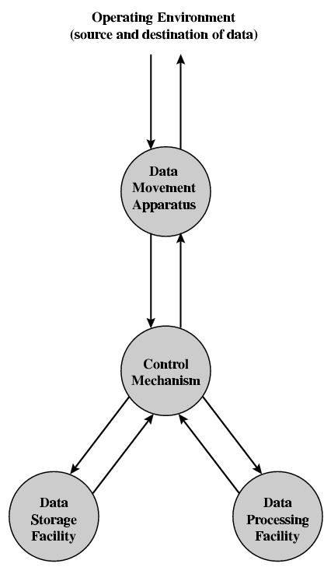
Functional View

Slide 21
Structure - Top Level
Peripherals
COMPUTER
Central
Processing
Unit
Main
Memory
Computer
Systems
Interconnection
Input/
Output
Communication
lines

Slide 22
Structure - Top Level
CPU
ALU
Registers
CPU
Internal CPU
Interconnection
(Bus)
Control unit

Slide 23
Von Neumann Architecture and Harvard Architecture
Von Neumann Architecture
Stored program concept
Three key concepts:
Data and instructions are stored in a single read – write memory
The contents of this memory are addressable by location, without regard to the type of data contained there
Execution occurs in a sequential fashion ( unless explicitly modified) from one instruction to the next

Slide 24
Contd…
Stored-program computers have the following characteristics:
Three hardware systems:
A central processing unit (CPU)
A main memory system
An I/O system
The capacity to carry out sequential instruction processing.
A single path between the CPU and main memory.
This single path is known as the von Neumann bottleneck.

Slide 25
Non-von Neumann Models
Conventional stored-program computers have undergone many incremental improvements over the years.
These improvements include adding specialized buses, floating-point units, and cache memories, to name only a few.
But enormous improvements in computational power require departure from the classic von Neumann architecture.
Adding processors is one approach.

Slide 26
Harvard Architecture
Uses separate memory for data and program
Example: MIPS processor

Slide 27
What is a program?
A sequence of steps
For each step, an arithmetic or logical operation is done
For each operation, a different set of control signals is needed
Hardwired program: process of connecting various components in the desired configuration as a form of programming
Data
Sequence of arithmetic
and
Logic functions
Results
(a) Programming in Hardware

Slide 28
Contd…
Software program: Uses general purpose configuration of arithmetic and logic functions and instruction interpreter which decodes the instruction codes and generates control signals that drives general purpose hardware.
Instruction Codes
Instruction
Interpreter
Control Signals
General Purpose
Arithmetic and Logic
functions
Data
Results
(b) Programming in software

Slide 29
Contd…
Hardwired systems are inflexible
Using software program General purpose hardware can do different tasks, given correct control signals
Instead of re-wiring, supply a new set of control signals

Slide 30
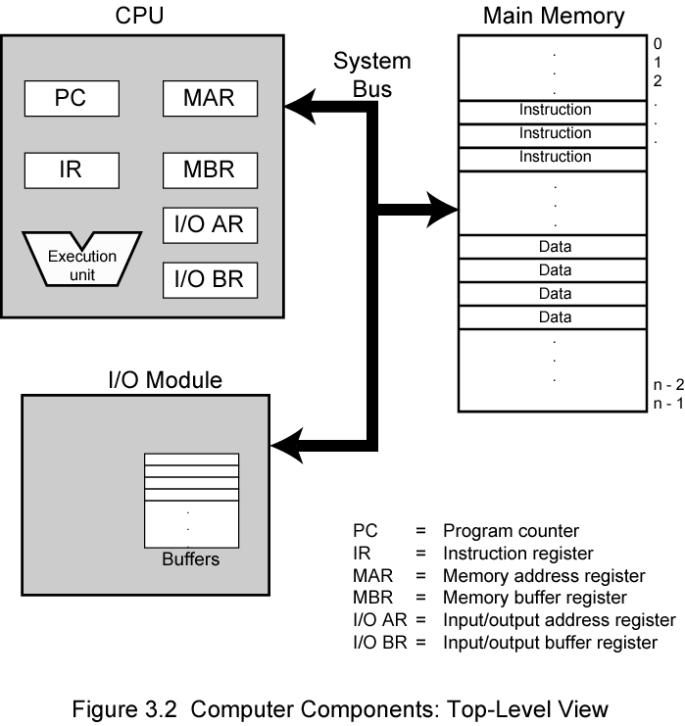
Computer Components: Top Level View

Slide 31
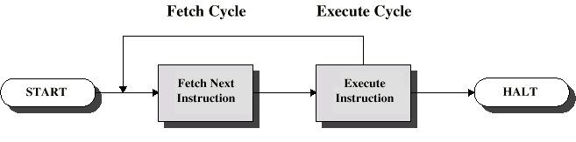
Instruction Cycle
Two steps:
Fetch
Execute

Slide 32
Fetch Cycle
Program Counter (PC) holds address of next instruction to fetch
Processor fetches instruction from memory location pointed to by PC
Increment PC
Unless told otherwise
Instruction loaded into Instruction Register (IR)
Processor interprets instruction and performs required actions

Slide 33
Execute Cycle
Processor-memory
data transfer between CPU and main memory
Processor-I/O
Data transfer between CPU and I/O module
Data processing
Some arithmetic or logical operation on data
Control
Alteration of sequence of operations
e.g. jump
Combination of above

Slide 34
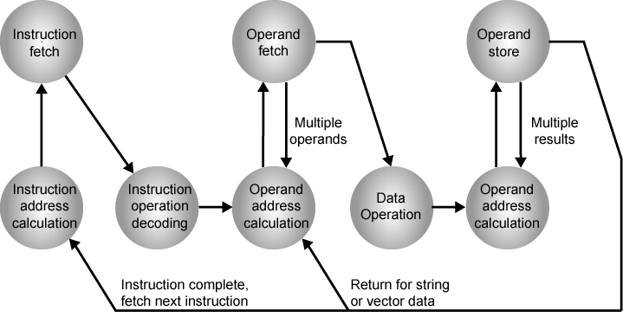
Instruction Cycle State Diagram

Slide 35
Interrupts
Mechanism by which other modules (e.g. I/O) may interrupt normal sequence of processing
Program
e.g. overflow, division by zero
Timer
Generated by internal processor timer
Used in pre-emptive multi-tasking
I/O
from I/O controller
Hardware failure
e.g. memory parity error

Slide 36
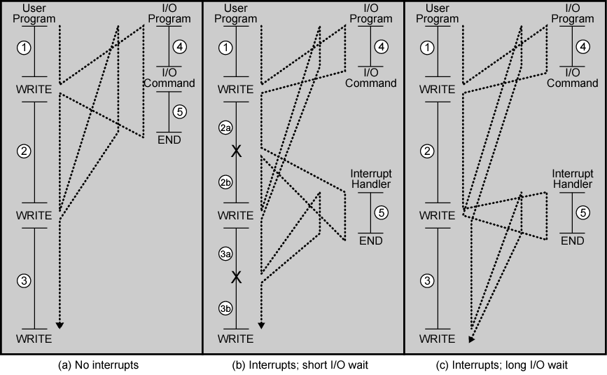
Program Flow Control

Slide 37
Interrupt Cycle
Added to instruction cycle
Processor checks for interrupt
Indicated by an interrupt signal
If no interrupt, fetch next instruction
If interrupt pending:
Suspend execution of current program
Save context
Set PC to starting address of interrupt handler routine
Process interrupt
Restore context and continue interrupted program

Slide 38
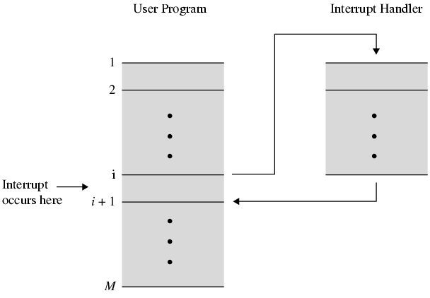
Transfer of Control via Interrupts

Slide 39
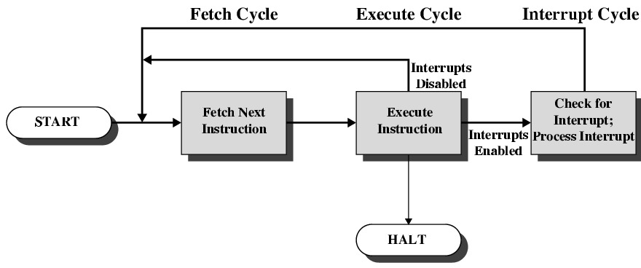
Instruction Cycle with Interrupts

Slide 40
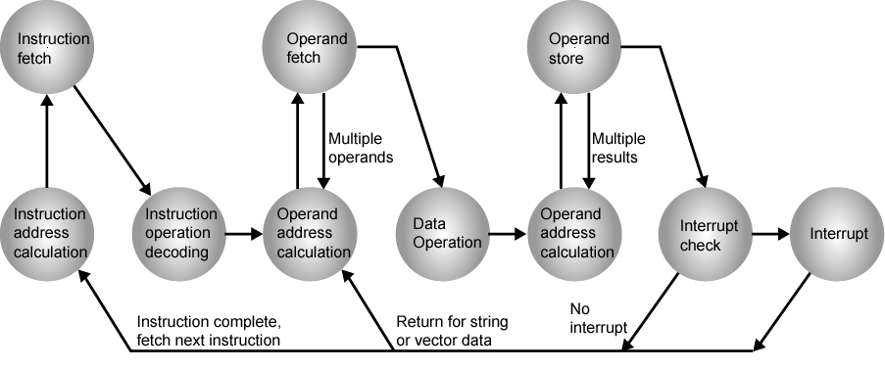
Instruction Cycle (with Interrupts) - State Diagram

Slide 41
Multiple Interrupts
Disable interrupts
Processor will ignore further interrupts whilst processing one interrupt
Interrupts remain pending and are checked after first interrupt has been processed
Interrupts handled in sequence as they occur
Define priorities
Low priority interrupts can be interrupted by higher priority interrupts
When higher priority interrupt has been processed, processor returns to previous interrupt

